Slide 1
IN1010 Uke 1(2) Lennard

Slide 2


Slide 3
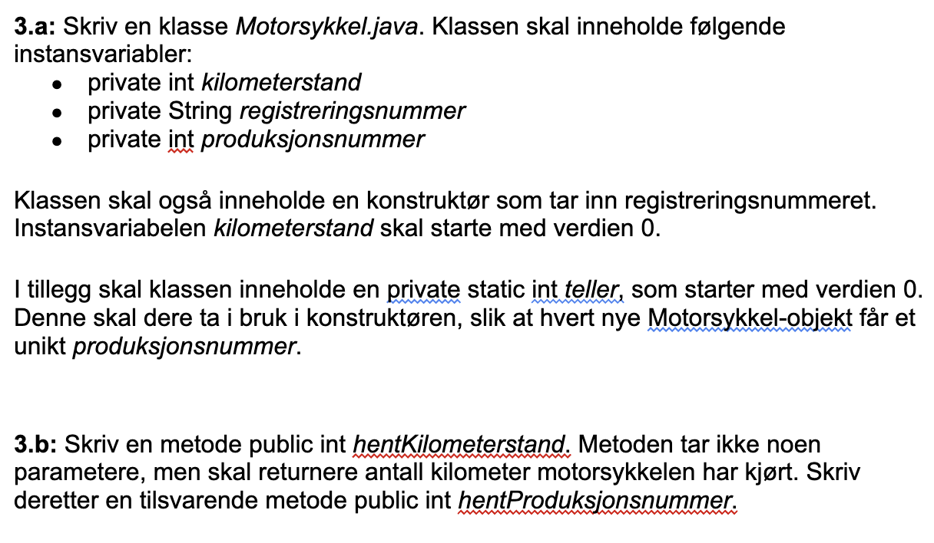

Slide 4
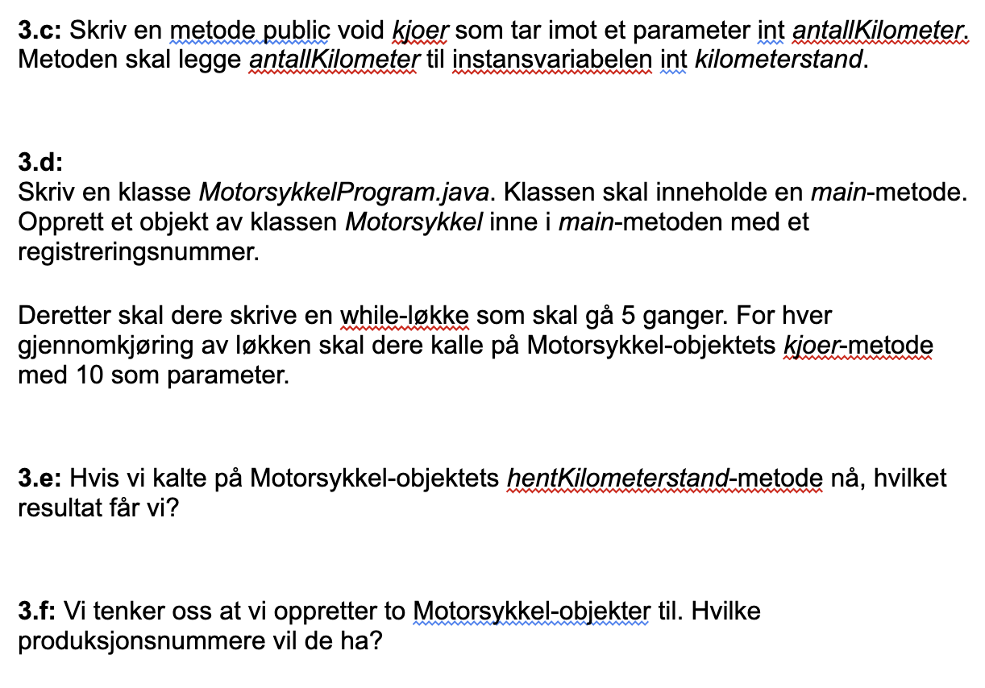

Slide 5
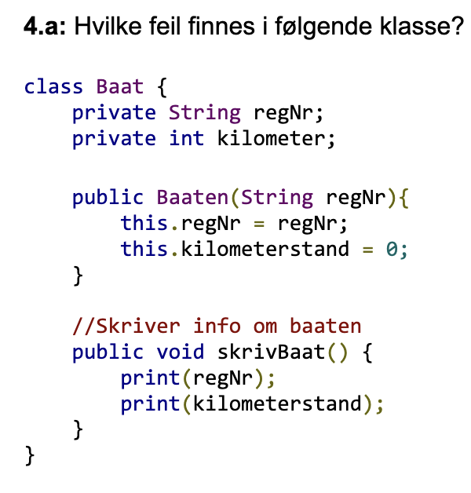

Slide 6
